Slide 1

IPL Data analysis
Presented By:
Arjun Naluvala

Slide 2
MBA graduate with interest in analytics and technology and Interested in understanding business problems using data
About Me
Why Data Analytics
I chose Data Analytics because I enjoy working with numbers and understanding patterns in data.
I like analyzing information and finding meaningful insights from it.
Data analytics helps businesses make better decisions based on real data instead of assumptions.

Slide 3
Introduction to the Speaker Arjun Naluvala Batch No: 477 Data Analytics Objectives of the Session
Understand the structure of IPL ball-by-ball dataset
Perform data cleaning and preprocessing
Apply univariate, bivariate, and multivariate analysis
Extract meaningful insights using visualization techniques

Slide 4
Introduction
Brief Overview of the Problem Statement
The objective of this project is to perform Exploratory Data Analysis (EDA) on the IPL ball-by-ball dataset. The dataset contains detailed information about matches, teams, players, and match outcomes.
The main goal is to clean the dataset, understand its structure, and analyze scoring patterns, match-winning trends, and player performance using Python. Through this analysis, meaningful insights are extracted to understand how data can support performance evaluation and decision-making.
Dataset Information

Slide 5
Dataset Information
Dataset Description
The dataset used in this project is the IPL ball-by-ball dataset. It contains detailed information about every delivery in IPL matches, including match details, team information, player performance, runs scored, wickets taken, venue details, and match results.
Each row in the dataset represents a single ball event, making it suitable for detailed performance and trend analysis.
The dataset contains:
278,205 rows
64 columns

Slide 6
Source / Platform
Source: Kaggle
Format: CSV (Comma-Separated Values)
Type: Structured Dataset
Category: Sports Analytics / Event-Level Data

Slide 7
Understanding the Dataset
Explanation of Columns
The IPL ball-by-ball dataset contains multiple columns representing match-level, team-level, and player-level information.
Some important columns include:
match_id – Unique identifier for each match
date – Date of the match
batting_team – Team currently batting
bowling_team – Team currently bowling
over – Over number in the match
batter – Name of the batsman
bowler – Name of the bowler
runs_batter – Runs scored by the batter on that ball

Slide 8
runs_total – Total runs scored on that delivery
wicket_kind – Type of dismissal (if any)
venue – Stadium where the match was played
season – IPL season year
match_won_by – Method of winning (Runs or Wickets)
Each row represents a single ball event.

Slide 9
Target Variable
The selected target variable for this analysis is:
Match_won_by
This variable represents how a match was won (by runs or wickets). It is used to analyze match outcome distribution and check class imbalance.

Slide 10
Initial Observations
The dataset contains 278,205 rows and 64 columns.
Some columns contain missing values, especially event-based fields like wicket_kind and extra_type.
No duplicate records were found.
The dataset is structured and suitable for detailed performance analysis.

Slide 11
Data Cleaning & Preparation
Missing Values Handling
Checked missing values using df.isnull().sum()
Identified event-based null values
Replaced them with appropriate labels without affecting match logic
Duplicate Records
Used df.duplicated().sum() to detect duplicates
No duplicate records were found

Slide 12
Class Imbalance
Checked distribution of match_won_by
Observed minor imbalance between runs and wickets
Dataset is suitable for analysis
Outlier Detection
Used boxplot to detect outliers in numerical columns
Verified that extreme values represent valid cricket events
No outliers were removed

Slide 13
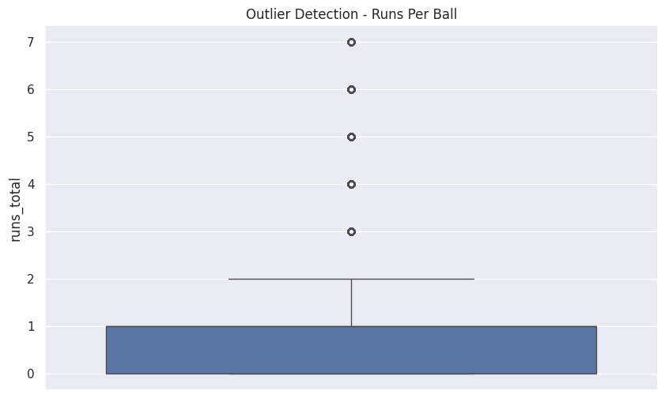
Outlier Detection: Distribution of Runs Per Ball

Slide 14
Why box plot was used:
A boxplot was used to detect extreme values in numerical columns such as runs_total.
Observation:
Some extreme values are visible in the upper range of runs.
Decision:
These values were retained because they represent valid cricket events and not data errors.

Slide 15
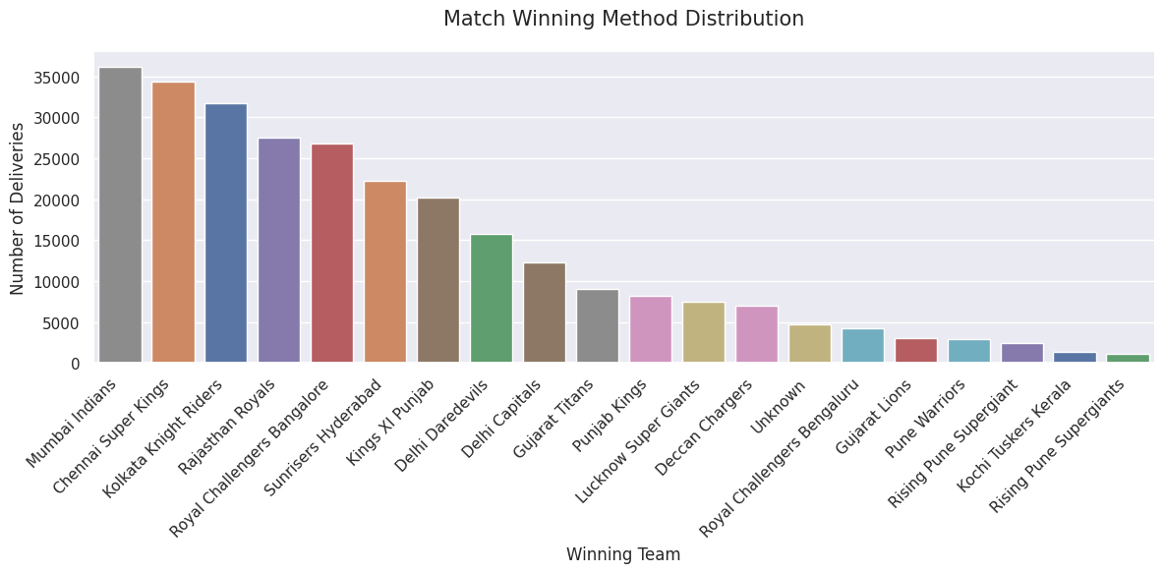
Class Imbalance: Bar Chart

Slide 16
Class Imbalance
Key Plot: Match Winning Team Distribution
Chart Type: Bar Chart(Categorical Comparison Chart).
Why this plot was used:
A bar chart was used to compare the number of match wins across different IPL teams.
Observation:
Mumbai Indians and Chennai Super Kings have the highest number of match wins.
Insight:
This indicates strong historical performance and consistency of these teams in IPL.

Slide 17
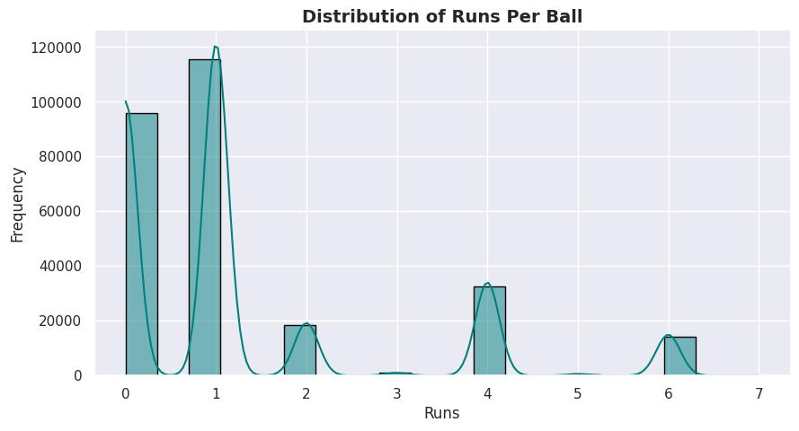
EDA – Univariate Analysis
Key Plot: Distribution of Runs Per Ball

Slide 18
Why this plot was used:
A histogram was used to understand how runs are distributed per delivery in IPL matches.
Observation:
The majority of deliveries result in 0 or 1 run. Very few deliveries result in high runs.
Insight:
This indicates that scoring in IPL is largely driven by singles and dot balls rather than big hits on every ball.

Slide 19
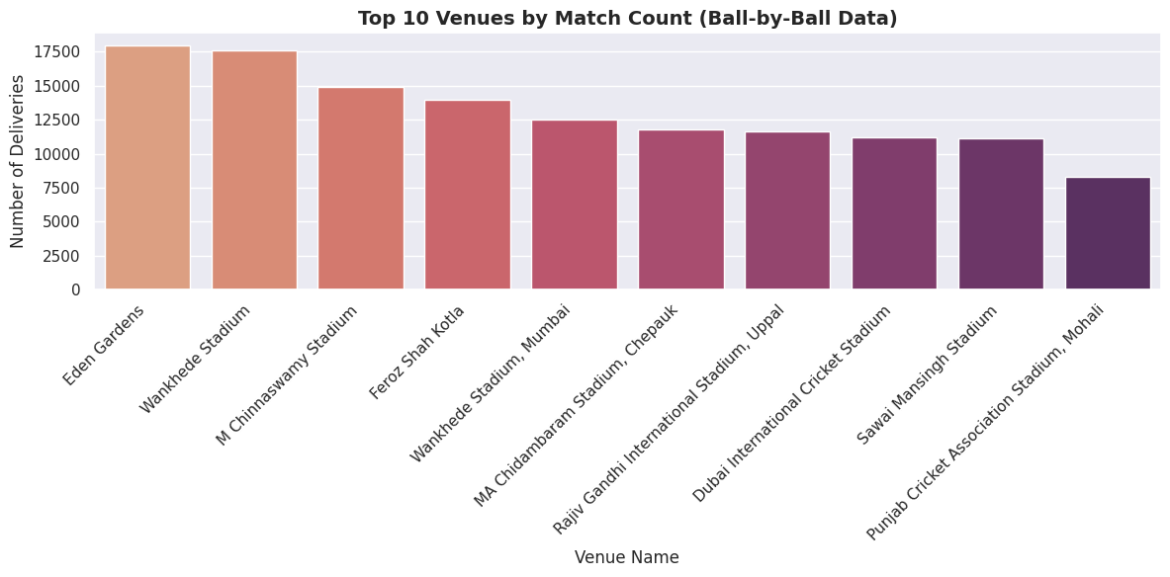
Key Plot: Match Winning Method Distribution

Slide 20
Why this plot was used:
A bar chart was used to compare the number of matches won by runs and wickets.
Observation:
Matches won by wickets are slightly higher compared to matches won by runs.
Insight:
This suggests that chasing teams often have a competitive advantage.

Slide 21
EDA – Bivariate Analysis
Important Relationship: Toss Winner vs Match Result
match_won_by | Chennai Super Kings | Deccan Chargers | Delhi Capitals | Delhi Daredevils | Gujarat Lions | Gujarat Titans | Kings XI Punjab | Kochi Tuskers Kerala | Kolkata Knight Riders | Lucknow Super Giants | Mumbai Indians | Pune Warriors | Punjab Kings | Rajasthan Royals | Rising Pune Supergiant | Rising Pune Supergiants | Royal Challengers Bangalore | Royal Challengers Bengaluru | Sunrisers Hyderabad | Unknown
toss_winner
Chennai Super Kings | 18807 | 244 | 493 | 952 | 0 | 493 | 1001 | 0 | 1177 | 0 | 1710 | 243 | 756 | 1925 | 0 | 0 | 1327 | 749 | 475 | 377
Deccan Chargers | 483 | 4624 | 0 | 1171 | 0 | 0 | 741 | 0 | 743 | 0 | 979 | 234 | 0 | 719 | 0 | 0 | 682 | 0 | 0 | 0
Delhi Capitals | 708 | 0 | 6921 | 0 | 0 | 247 | 488 | 0 | 734 | 251 | 1455 | 0 | 250 | 753 | 0 | 0 | 741 | 247 | 735 | 519
Delhi Daredevils | 1221 | 0 | 0 | 8117 | 242 | 0 | 1601 | 0 | 1183 | 0 | 2123 | 252 | 0 | 1590 | 0 | 0 | 1229 | 0 | 927 | 63
Gujarat Lions | 0 | 0 | 0 | 0 | 2342 | 0 | 490 | 0 | 0 | 0 | 0 | 0 | 0 | 0 | 0 | 0 | 491 | 0 | 0 | 263
Gujarat Titans | 507 | 0 | 247 | 0 | 0 | 4605 | 0 | 0 | 250 | 254 | 489 | 0 | 483 | 0 | 0 | 0 | 237 | 0 | 0 | 0
Kings XI Punjab | 933 | 482 | 0 | 738 | 0 | 0 | 8266 | 0 | 1941 | 0 | 1716 | 436 | 0 | 1466 | 0 | 250 | 1629 | 0 | 1955 | 514
Kochi Tuskers Kerala | 0 | 228 | 0 | 0 | 0 | 0 | 0 | 830 | 0 | 0 | 0 | 246 | 0 | 0 | 0 | 0 | 456 | 0 | 0 | 0
Kolkata Knight Riders | 2606 | 199 | 495 | 1208 | 0 | 249 | 1464 | 492 | 16621 | 727 | 2436 | 244 | 222 | 997 | 0 | 0 | 706 | 0 | 1428 | 267
Lucknow Super Giants | 260 | 0 | 492 | 0 | 0 | 250 | 0 | 0 | 232 | 3213 | 251 | 0 | 253 | 250 | 0 | 0 | 510 | 0 | 183 | 0
Mumbai Indians | 1467 | 0 | 742 | 1468 | 0 | 992 | 2162 | 0 | 1401 | 1268 | 19397 | 247 | 504 | 1434 | 497 | 218 | 1715 | 253 | 1692 | 780
Pune Warriors | 738 | 0 | 0 | 469 | 0 | 0 | 198 | 0 | 0 | 0 | 715 | 742 | 0 | 470 | 0 | 0 | 990 | 0 | 476 | 0
Punjab Kings | 249 | 0 | 498 | 0 | 0 | 239 | 0 | 0 | 249 | 510 | 252 | 0 | 3986 | 761 | 0 | 0 | 236 | 484 | 982 | 193
Rajasthan Royals | 2944 | 243 | 980 | 619 | 0 | 937 | 1241 | 0 | 1670 | 245 | 1975 | 239 | 740 | 14628 | 0 | 0 | 1214 | 253 | 1741 | 703
Rising Pune Supergiant | 0 | 0 | 0 | 226 | 0 | 0 | 0 | 0 | 0 | 0 | 0 | 0 | 0 | 0 | 1145 | 0 | 0 | 0 | 0 | 0
Rising Pune Supergiants | 0 | 0 | 0 | 0 | 233 | 0 | 237 | 0 | 142 | 0 | 0 | 0 | 0 | 0 | 0 | 637 | 254 | 0 | 0 | 0
Royal Challengers Bangalore | 1487 | 993 | 480 | 741 | 246 | 244 | 1780 | 0 | 2064 | 0 | 1506 | 0 | 498 | 992 | 495 | 0 | 13049 | 0 | 1477 | 649
Royal Challengers Bengaluru | 249 | 0 | 0 | 0 | 0 | 0 | 0 | 0 | 253 | 248 | 0 | 0 | 0 | 0 | 0 | 0 | 0 | 2258 | 512 | 0
Sunrisers Hyderabad | 1712 | 0 | 948 | 0 | 0 | 744 | 493 | 0 | 3069 | 714 | 1181 | 0 | 466 | 1481 | 246 | 0 | 1335 | 0 | 9600 | 374

Slide 22
Why this chart was used:
This chart was used to analyze whether winning the toss influences match results.
Observation:
Toss winners do not always win the match.
Insight:
This shows that match outcome depends more on performance rather than toss advantage.

Slide 23
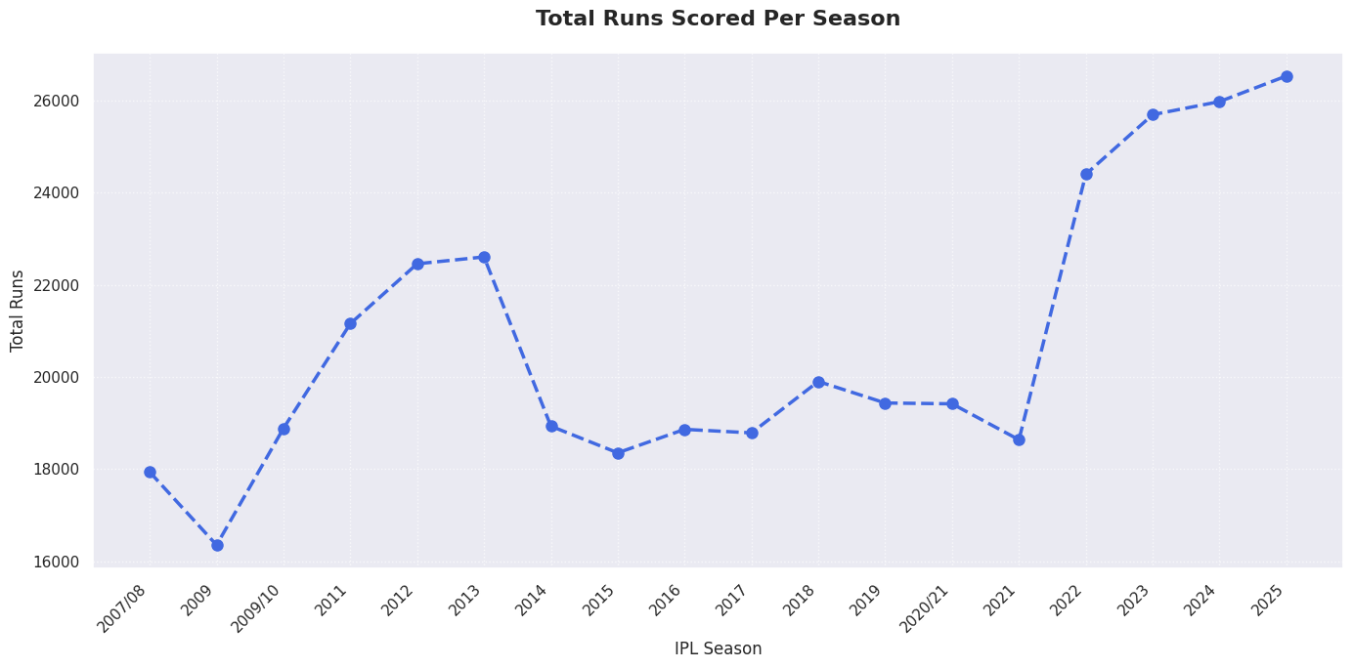
Important Relationship: Season vs Total Runs

Slide 24
Why this plot was used:
A line plot was used to analyze scoring trends across different IPL seasons.
Observation:
Some seasons show higher total runs compared to others.
Insight:
This may indicate changes in pitch conditions, player performance, or game strategies over time.

Slide 25
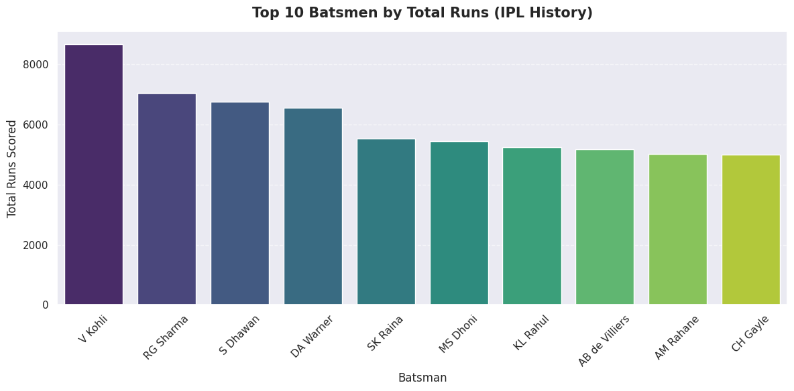
EDA – Multivariate Analysis
Advanced Plot: Top 10 Batsmen by Total Runs

Slide 26
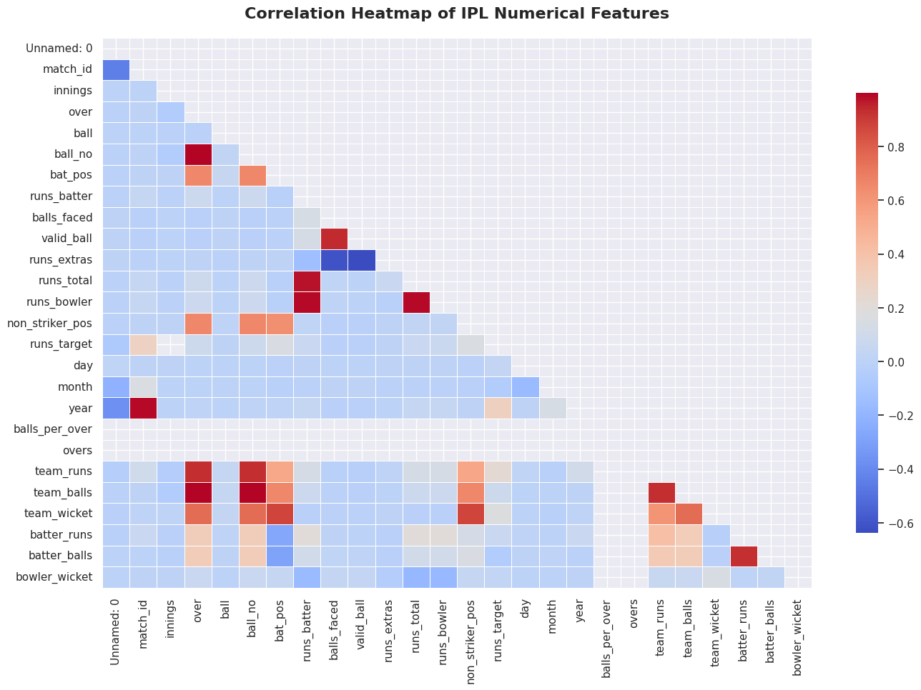
Advanced Plot: Correlation Heatmap

Slide 27
Why this plot was used:
A heatmap was used to understand relationships between numerical variables.
Observation:
There is a strong positive correlation between runs_total and runs_batter.
Insight:
This confirms that batter performance significantly influences total runs scored.

Slide 28
Visual & Non-Visual Insights
Pivot Tables / Summary Statistics
Created pivot table to calculate season-wise total runs.
Used groupby() to summarize team and player performance.
Applied summary statistics using describe() to analyze:
Mean runs per ball
Maximum runs scored
Distribution spread
Aggregated ball-level data into season-level insights.

Slide 29
Pivot table summarizes total runs by season and winning team
match_won_by | Chennai Super Kings | Deccan Chargers | Delhi Capitals | Delhi Daredevils | Gujarat Lions | Gujarat Titans | Kings XI Punjab | Kochi Tuskers Kerala | Kolkata Knight Riders | Lucknow Super Giants | Mumbai Indians | Pune Warriors | Punjab Kings | Rajasthan Royals | Rising Pune Supergiant | Rising Pune Supergiants | Royal Challengers Bangalore | Royal Challengers Bengaluru | Sunrisers Hyderabad | Unknown
season
2007/08 | 2945 | 601 | 0 | 2302 | 0 | 0 | 3179 | 0 | 1756 | 0 | 1805 | 0 | 0 | 4135 | 0 | 0 | 1214 | 0 | 0 | 0
2009 | 2288 | 2670 | 0 | 2872 | 0 | 0 | 1981 | 0 | 817 | 0 | 1419 | 0 | 0 | 1417 | 0 | 0 | 2556 | 0 | 0 | 333
2009/10 | 2975 | 2582 | 0 | 2099 | 0 | 0 | 939 | 0 | 2128 | 0 | 3649 | 0 | 0 | 1899 | 0 | 0 | 2321 | 0 | 0 | 291
2011 | 3461 | 1688 | 0 | 1440 | 0 | 0 | 2327 | 1661 | 2050 | 0 | 2912 | 1036 | 0 | 1544 | 0 | 0 | 2979 | 0 | 0 | 56
2012 | 3137 | 1204 | 0 | 3123 | 0 | 0 | 2392 | 0 | 3446 | 0 | 3006 | 1215 | 0 | 2238 | 0 | 0 | 2692 | 0 | 0 | 0
2013 | 3835 | 0 | 0 | 912 | 0 | 0 | 2506 | 0 | 1622 | 0 | 3989 | 1226 | 0 | 3262 | 0 | 0 | 2488 | 0 | 2137 | 625
2014 | 3006 | 0 | 0 | 584 | 0 | 0 | 4132 | 0 | 3462 | 0 | 2371 | 0 | 0 | 1768 | 0 | 0 | 1471 | 0 | 1811 | 326
2015 | 3049 | 0 | 0 | 1483 | 0 | 0 | 526 | 0 | 2274 | 0 | 3279 | 0 | 0 | 2321 | 0 | 0 | 2292 | 0 | 2337 | 792
2016 | 0 | 0 | 0 | 2184 | 2952 | 0 | 1194 | 0 | 2270 | 0 | 2377 | 0 | 0 | 0 | 0 | 1329 | 3147 | 0 | 3409 | 0
2017 | 0 | 0 | 0 | 2155 | 1368 | 0 | 2140 | 0 | 2732 | 0 | 3399 | 0 | 0 | 0 | 2971 | 0 | 1016 | 0 | 2682 | 323
2018 | 3830 | 0 | 0 | 1741 | 0 | 0 | 2000 | 0 | 3117 | 0 | 2105 | 0 | 0 | 2254 | 0 | 0 | 1954 | 0 | 2900 | 0
2019 | 2853 | 0 | 2953 | 0 | 0 | 0 | 2021 | 0 | 2260 | 0 | 3028 | 0 | 0 | 1693 | 0 | 0 | 1824 | 0 | 1971 | 831
2020/21 | 1953 | 0 | 2739 | 0 | 0 | 0 | 1533 | 0 | 1899 | 0 | 3448 | 0 | 0 | 2199 | 0 | 0 | 1760 | 0 | 2427 | 1458
2021 | 3546 | 0 | 2773 | 0 | 0 | 0 | 0 | 0 | 2408 | 0 | 2245 | 0 | 1876 | 1696 | 0 | 0 | 2910 | 0 | 850 | 333
2022 | 1436 | 0 | 2287 | 0 | 0 | 3892 | 0 | 0 | 1753 | 3096 | 1187 | 0 | 2435 | 3494 | 0 | 0 | 2999 | 0 | 1816 | 0
2023 | 3544 | 0 | 1570 | 0 | 0 | 3749 | 0 | 0 | 2106 | 2832 | 3434 | 0 | 2165 | 2426 | 0 | 0 | 2200 | 0 | 1537 | 125
2024 | 2306 | 0 | 2647 | 0 | 0 | 1770 | 0 | 0 | 3826 | 2482 | 1556 | 0 | 1887 | 3197 | 0 | 0 | 0 | 2594 | 3706 | 0
2025 | 1386 | 0 | 2156 | 0 | 0 | 3256 | 0 | 0 | 1639 | 2410 | 3052 | 0 | 3670 | 1514 | 0 | 0 | 0 | 3975 | 2606 | 863

Slide 30
Why this was used:
Pivot tables and summary statistics were used to convert detailed ball-by-ball data into structured seasonal insights.
Observation:
Certain seasons recorded higher total runs and more wickets compared to others.
Insight:
Scoring trends and match dynamics vary across seasons, indicating evolution in batting strategies and team performance.

Slide 31
Key Takeaways
Mumbai Indians and Chennai Super Kings show consistent dominance.
Most deliveries result in 0 or 1 run.
Winning the toss does not guarantee match victory.
A small group of players contribute significantly to total runs.
Data aggregation helps transform raw event-level data into meaningful insights.

Slide 32
Which Year – Which Player Scored the Most Runs
 | season | batter | runs_batter
115 | 2007/08 | SE Marsh | 616
229 | 2009 | ML Hayden | 572
446 | 2009/10 | SR Tendulkar | 618
502 | 2011 | CH Gayle | 608
684 | 2012 | CH Gayle | 733
910 | 2013 | MEK Hussey | 733
1088 | 2014 | RV Uthappa | 660
1148 | 2015 | DA Warner | 562
1383 | 2016 | V Kohli | 973
1422 | 2017 | DA Warner | 641
1594 | 2018 | KS Williamson | 735
1694 | 2019 | DA Warner | 692
1866 | 2020/21 | KL Rahul | 676
2051 | 2021 | RD Gaikwad | 635
2144 | 2022 | JC Buttler | 863
2423 | 2023 | Shubman Gill | 890
2606 | 2024 | V Kohli | 741
2640 | 2025 | B Sai Sudharsan | 759

Slide 33
Why this analysis was performed:
To identify the highest run-scoring player in each IPL season.
Observation:
Each season has a different leading run scorer, though some players appear multiple times across seasons.
Insight:
This highlights both season-specific peak performances and long-term consistency of certain players.

Slide 34
Most Runs by a Player in IPL Overall
 | runs_batter
batter
V Kohli | 8671
RG Sharma | 7048
S Dhawan | 6769
DA Warner | 6567
SK Raina | 5536
MS Dhoni | 5439
KL Rahul | 5235
AB de Villiers | 5181
AM Rahane | 5032
CH Gayle | 4997

Slide 35
Why this analysis was performed:
To determine the highest cumulative run scorer in IPL history.
Observation:
The top player has significantly higher total runs compared to others.
Insight:
Consistent long-term performance across seasons contributes to overall dominance in IPL statistics.

Slide 36
Man of the Match – All Seasons
 | Awards_Count
player_of_match
AB de Villiers | 6170
CH Gayle | 5186
RG Sharma | 5134
MS Dhoni | 4384
DA Warner | 4329
V Kohli | 4302
SP Narine | 4018
AD Russell | 3905
RA Jadeja | 3864
SR Watson | 3807

Slide 37
Why this analysis was performed:
To identify players who have received the highest number of 'Player of the Match' awards.
Observation:
Certain players have won the award multiple times, indicating impactful performances.
Insight:
Frequent Player of the Match awards reflect match-winning contributions and individual influence on game outcomes.

Slide 38
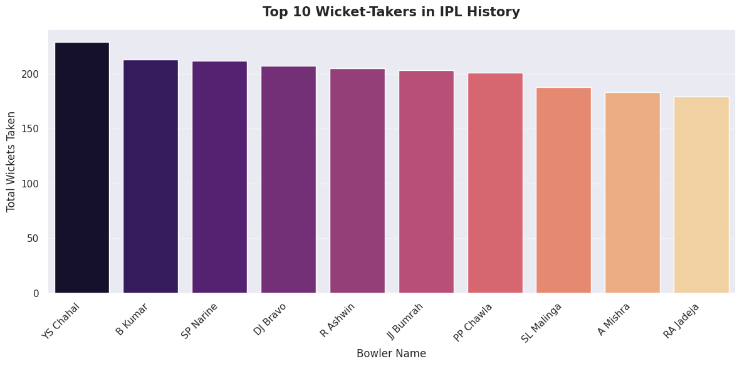
Top 10 Bowlers by Wickets

Slide 39
Why this plot was used:
A bar chart was used to identify the top 10 bowlers based on the total number of wickets taken across IPL seasons.
Observation:
A few bowlers have significantly higher wicket counts compared to others. The difference between the top bowlers and the rest is clearly visible.

Slide 40
Insight:
This indicates that certain bowlers have consistently contributed to their team's success by taking crucial wickets. Strong bowling performance plays a major role in controlling the game and limiting the opponent's score.
Conclusion:
Wicket-taking consistency is an important factor in long-term team performance and match outcomes.

Slide 41
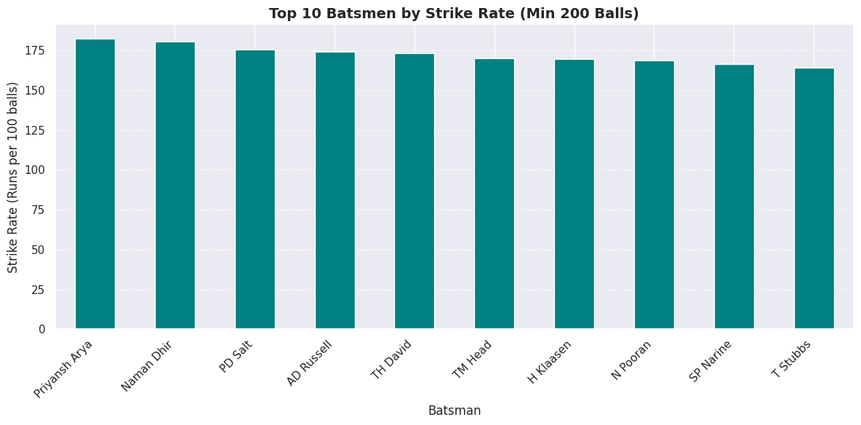
Strike Rate Analysis (Top Batsmen)

Slide 42
Why this plot was used:
A bar chart was used to analyze the strike rate of top batsmen to understand their scoring efficiency.
Observation:
Some batsmen have significantly higher strike rates compared to others, indicating faster scoring ability.
Insight:
A higher strike rate reflects aggressive batting style and the ability to score runs quickly, which is crucial in T20 format matches like IPL.
Conclusion:
Strike rate analysis highlights not just consistency in scoring but also scoring efficiency, which plays a vital role in match outcomes.

Slide 43
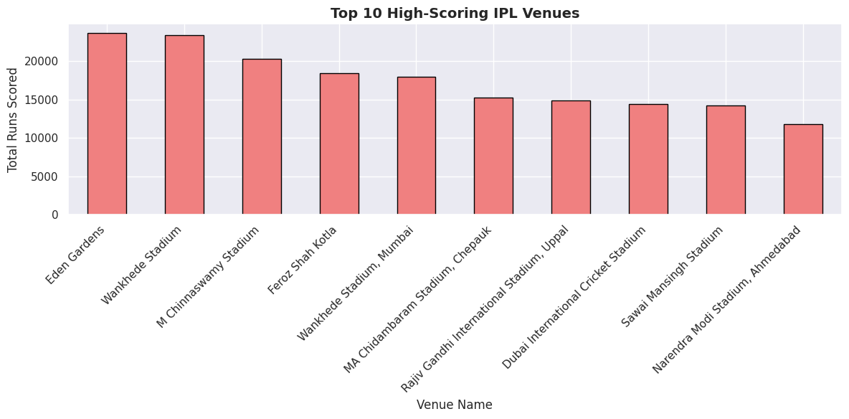
Venue Performance Analysis

Slide 44
Why this plot was used:
A bar chart was used to analyze total runs scored across different venues to understand how match performance varies by location.
Observation:
Some venues have significantly higher total runs compared to others, indicating higher scoring matches at those locations.
Insight:
This suggests that certain venues are more batting-friendly, possibly due to pitch conditions, ground dimensions, or environmental factors.
Conclusion:
Venue plays an important role in influencing match outcomes and scoring patterns in IPL matches.

Slide 45
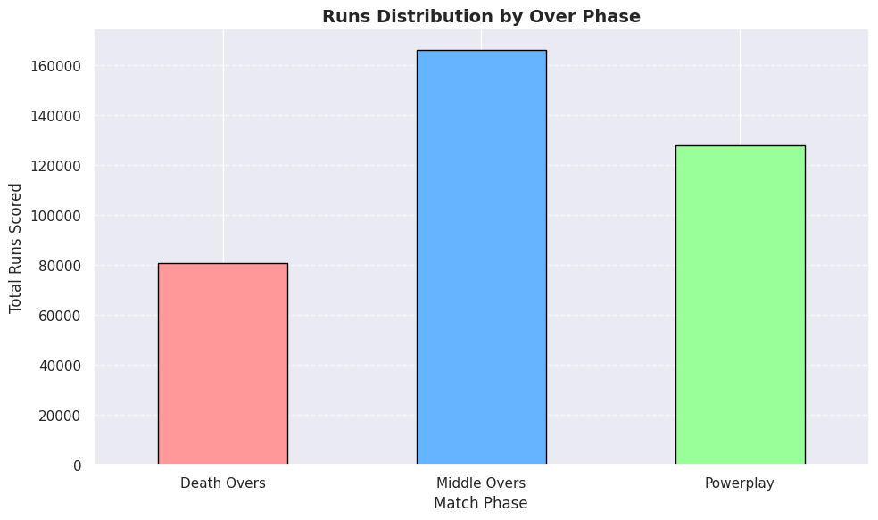
Powerplay vs Death Overs Analysis

Slide 46
Conclusion
Final Insights
The IPL ball-by-ball dataset was successfully cleaned and structured for analysis.
Event-based missing values were handled logically without distorting match-level information.
No duplicate records were found, ensuring data integrity.
Outliers were examined and retained as they represent valid cricket scenarios.

Slide 47
Univariate, bivariate, and multivariate analysis revealed scoring patterns, match-winning trends, and player performance insights.
Aggregation techniques such as groupby() and pivot_table() were used to derive season-level and player-level metrics from event-level data.
The project demonstrates strong understanding of data cleaning, feature interpretation, and structured Python-based Exploratory Data Analysis (EDA).
This analysis reflects the ability to transform raw event data into meaningful analytical insights.

Slide 48
Learnings from the Project
Learned how to clean real-world structured datasets.
Practiced handling missing values and validating outliers.
Applied univariate, bivariate, and multivariate analysis.
Used visualization to communicate insights effectively.
Understood how to transform raw data into decision-support insights.

Slide 49
Thank You

